Slide 1
Dissociated neuronal phase- and amplitude-coupling patterns in the human brain
Marcus Siems and Markus Siegel

Slide 2
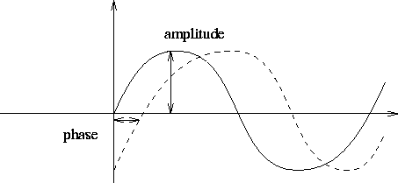
Overview
Elucidating phase and amplitude coupling relationship in MEG
Notes:
- Phase-coupling, Long-range phase-coupling reflects some cognitive processes
- Amplitude-coupling (or power coupling) are more stable than phase coupling and might reflect structured cortical networks.

Slide 3
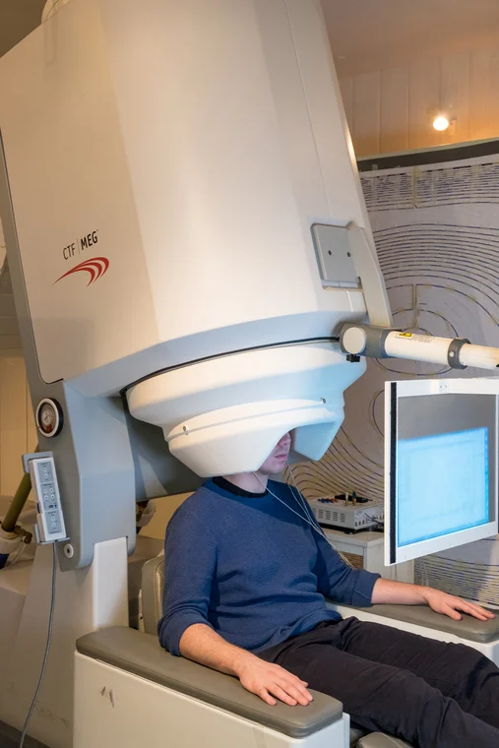
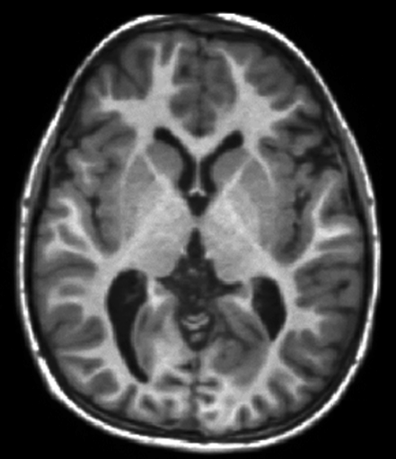
Materials
95 healthy resting state MEG from Human Connectome Project (3 x 6 minutes)

Slide 4
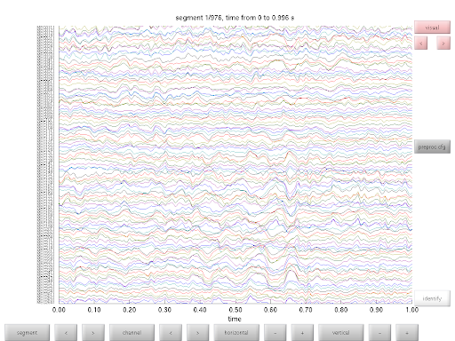
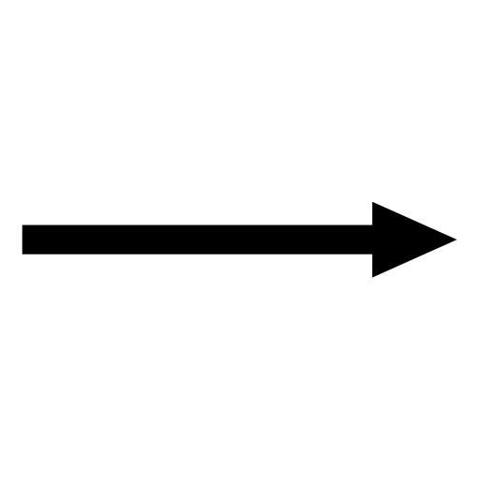
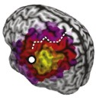
Method: Pre-Processing
ICA + Cleaning
Source Localization

Slide 5
Method: Pre-Processing
Source Localization:
- FieldTrip
- Single Shell Model Using T1
- 457 Source for Forward (MNI to Headspace)
- 3 Head Localization Coils for Co-registering
- Linear Beamforming

Slide 6
Method: Analysis Technique
Time → Frequency
- Used Morlet’s Wavelet (1-128Hz)
Phase Coupling : wPLI (not affected by Volume Conduction)
Amplitude Coupling: AEC (affected by Volume Conduction)

Slide 7
Method: Analysis Technique

Slide 8
Research Question 1
Is there a genuine component to the cortical amplitude-coupling measured with MEG, beyond the spurious amplitude-coupling induced by phase-coupling?
Palva, J.M., Wang, S.H., Palva, S., Zhigalov, A., Monto, S., Brookes, M.J., Schoffelen, J.-M., Jerbi, K., 2018. Ghost interactions in MEG/EEG source space: a note of caution on inter-areal coupling measures. Neuroimage 173, 632–643. https://doi.org/10.1016/j.neuroimage.2018.02.032.

Slide 9
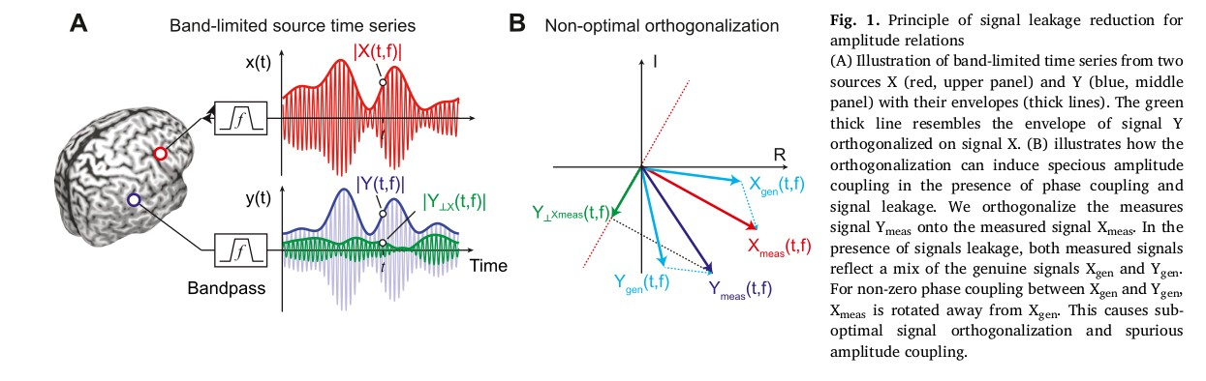
Research Question 1

Slide 10
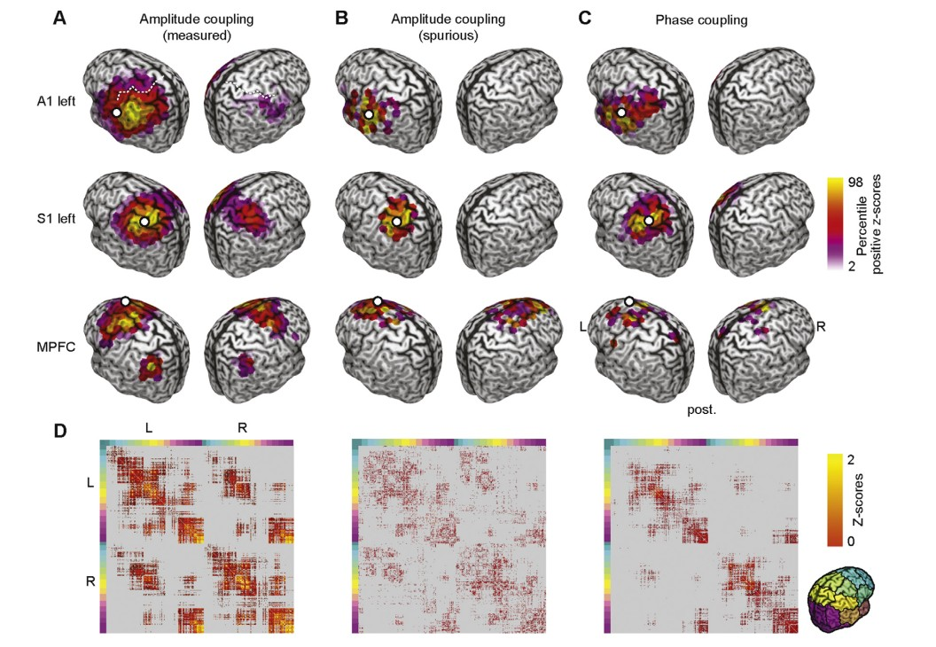
Research Question 1
Simulated the amplitude coupling to isolate the spurious components using parametric models.

Slide 11
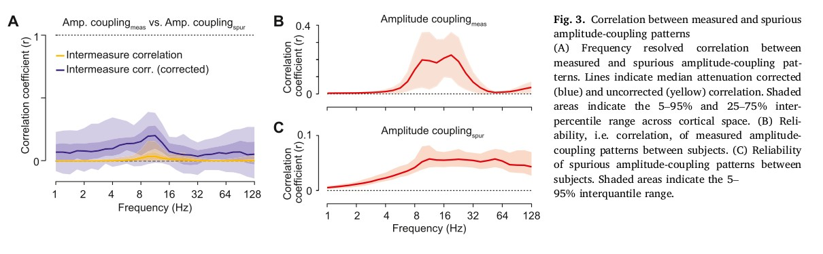
Research Question 1
They then looked if the spurious part of the simulation was correlated with the real measured phase amplitude coupling .

Slide 12
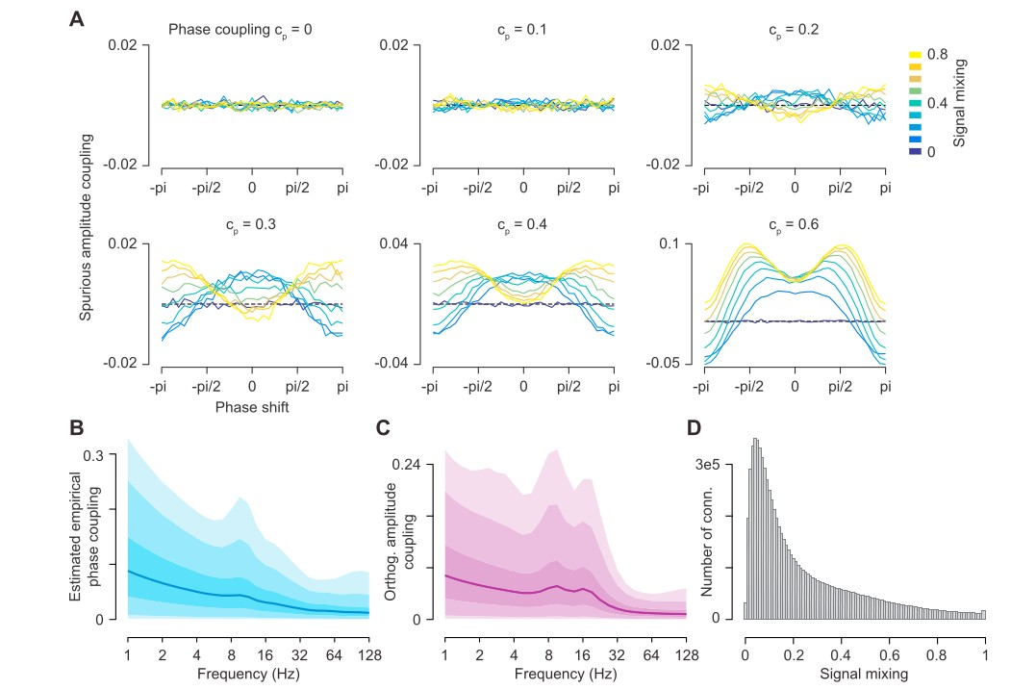
Research Question 1
Simulated how to get phase / amplitude mixing by tweaking phase coupling.

Slide 13
Result 1
Amplitude coupling has a genuine effect in even though the phase is affecting that coupling in the orthogonalization stage.

Slide 14
Research Question 2
Is the amplitude and phase coupling patterns of cortical connectivity different.
* Similar Question we are asking in: Envelope- and phase-based measures of functional connectivity are complementary in the classification of states of consciousness

Slide 15
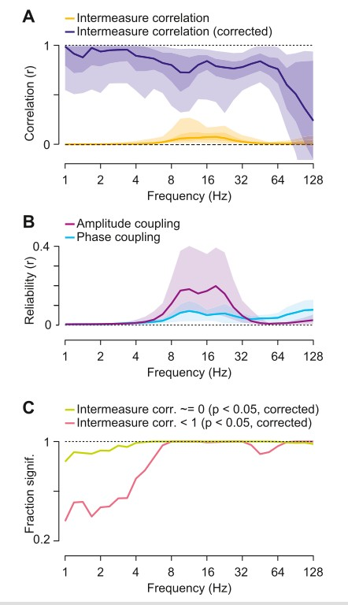
Research Question 2

Slide 16
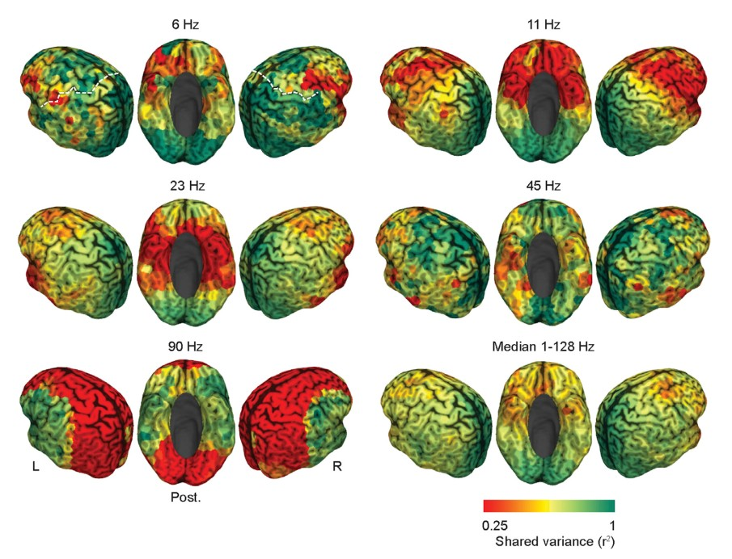
Research Question 2

Slide 17
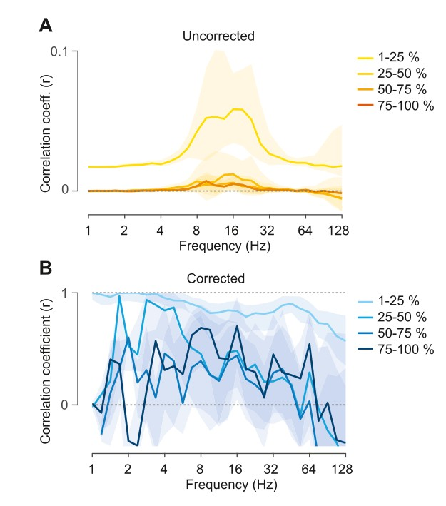
Research Question 2

Slide 18
Result 2
Is the amplitude and phase coupling patterns of cortical connectivity are different.
There are similar, but not identical. The difference is mostly in the long range correlation.

